Slide 1
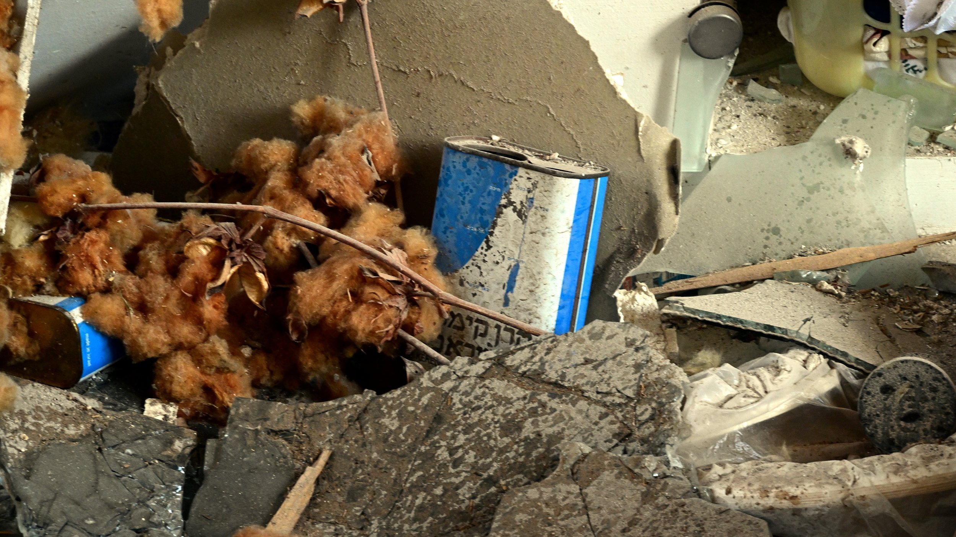
KKL-JNF Clearing the Scars of War in Southern Israel

Slide 2
KKL-JNF has allocated massive resources to rehabilitate the Western Negev following the October 7th terror attacks:
Projects to repair and remove the scars of war.
Projects to rebuild the devastated communities and boost their resilience.
Projects to facilitate the return of the evacuees to their homes in the Western Negev.
Important - restoring the region is not just about rebuilding infrastructure; it is about healing the scars of war inflicted during the attacks. Part of the rehabilitation process includes clearing the area of any signs of war. The residents of the south have suffered terribly, and we must ensure that the scars of war and other unpleasant reminders are removed from the public eye.
Your Support in These Efforts is Crucial!

Slide 3
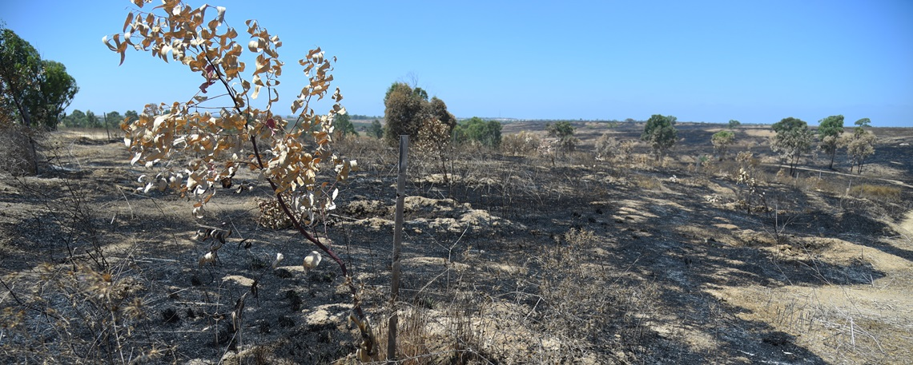
Restoring the Beeri Forest Watch Tower: Protecting Israel's Forests
Project – the Beeri Tower serves as a lookout, watching over the forests for signs of fire and other threats.
Problem - the tower was heavily damaged by Hamas terrorists.
Solution - comprehensive restoration efforts to make the tower functional again.
Project number - 21322
Project cost – NIS 444,110 - 888,220

Slide 4
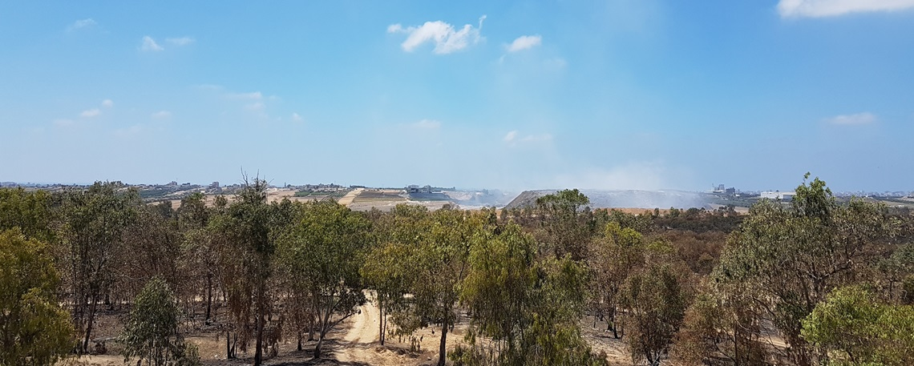
Repairing the Battle - Scarred Road in Be'eri Forest
Project – A crucial artery in Be'eri Forest - the Water Facilities Road, is essential for public access, forest maintenance, and emergency services.
Problem - this vital route has sustained significant damage.
Solution - comprehensive restoration efforts to ensure its functionality.
Project number - 21142
Project cost – NIS 501,930 - 1,003,860

Slide 5
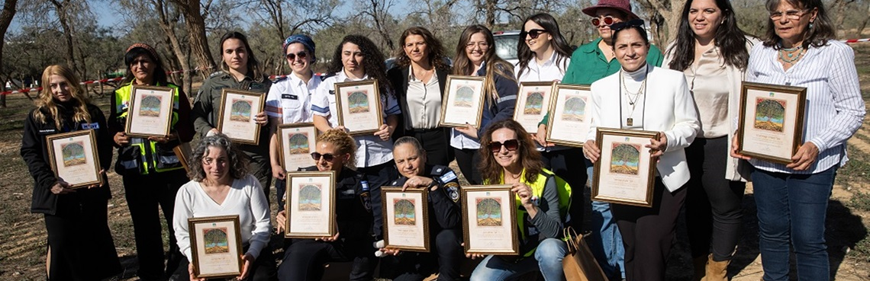
Heroines Path: KKL-JNF Honors Feminine Courage, Celebrates Israeli Resilience
KKL-JNF invites you to join us in commemorating the extraordinary bravery of remarkable Israeli women who emerged as beacons of unimaginable courage amid the darkness of the October 7th terror attacks.
Heroines Path, in the Ofakim Park in southern Israel, stands as a testament to their courage, resilience, and unwavering commitment to saving lives.
Project number - 21094
Project cost – NIS 389,372 - 778,745
For More info – CLICK HERE

Slide 6
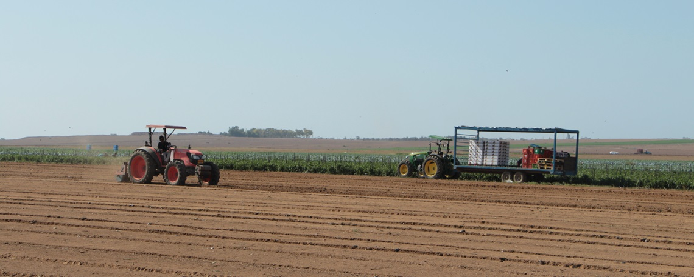
Reviving the Land, Restoring Hope: Agricultural Renewal in Southern Israel
Project – Recognizing the urgent need to restore agricultural productivity, KKL-JNF has launched a plan to develop agricultural fields spanning 1,200 dunams.
Problem - Greenhouses in the communities near Gaza were reduced to piles of rubbish, and vast stretches of agricultural fields lay in ruin.
Solution - land, once an IDF training ground, has been meticulously cleared of munitions ahead of it becoming new fields.
Project number - 20998
Project cost – NIS 50,000 - 7,807,244

Slide 7
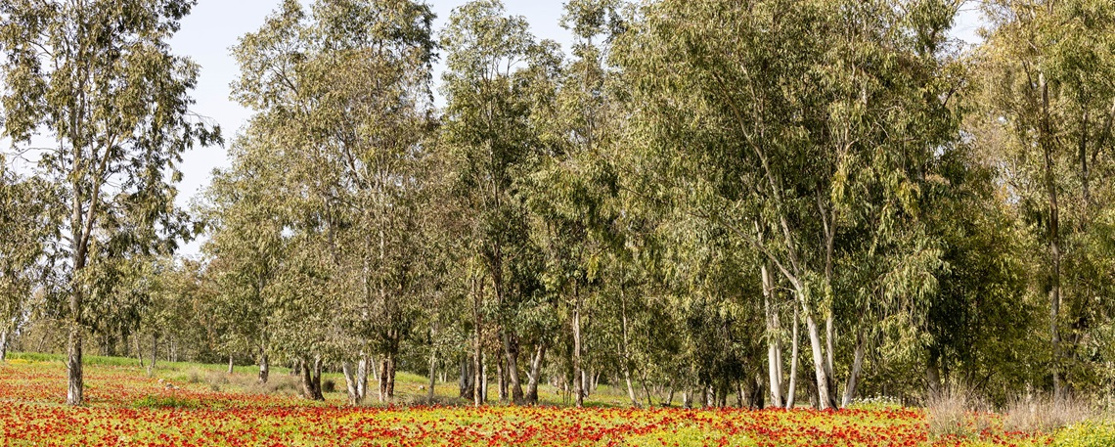
Restoring the Shokeda Forest Access Road
Project –the Shokeda Forest access road - a vital artery, was battered by the chaos of war.
Problem - the road stands in dire need of repair.
Solution - resurfacing and strengthening the road to ensure it can withstand the traffic of maintenance vehicles, emergency responders, and visitors alike.
Project number - 21141
Project cost – NIS 501,930 - 1,003,860

Slide 8
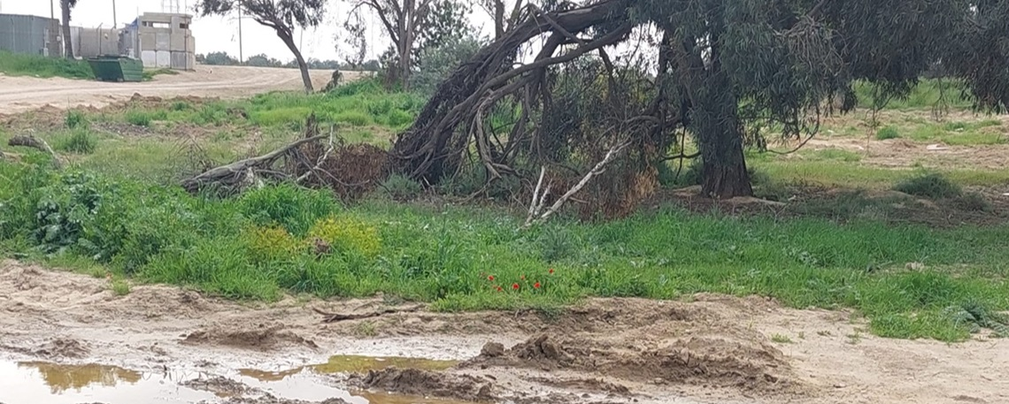
Restore and Renew: Rehabilitation of the Magen Forest in the Western Negev
Project – restoring the Magen Forest which served as a "green belt" around the kibbutzim and nearby communities.
Problem - On October 7th, the Magen Forest endured devastating damage from the Hamas terror attacks and the subsequent war.
Solution - KKL-JNF has launched a project to clear the destruction from this area.
Project number - 21323
Project cost – NIS 462,047 - 924,094

Slide 9
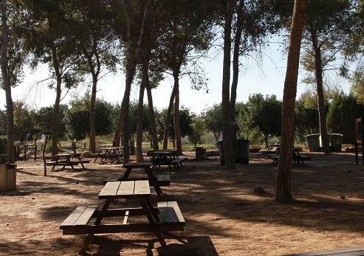
Restoring the Critical Access Roads in the KKL-JNF Assaf Simhoni Grove
Project – restoring two routes running through the KKL-JNF's Assaf Simhoni Grove.
Problem - Roads running through the KKL-JNF's Assaf Simhoni Grove were heavily damaged following the October 7th attacks.
Solution - KKL-JNF is restoring them.
Project number - 21658
Project cost – NIS 230,935 - 461,870

Slide 10
By contributing to these projects, you are making a powerful statement - even in the face of adversity and terrorism, we can come together to restore and rebuild. THANK YOU!

